Slide 1
COMMUNICATION SKILLS
IMPORTANCE OF READING

Slide 2
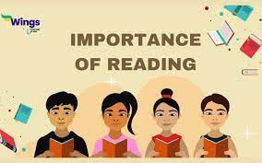

Slide 3


Slide 4
Reading is crucial for various reasons.
It enhances knowledge , vocabulary , and critical thinking skills.
It opens door to new ideas , cultures and perspectives , fostering empathy and understanding.
Reading also improves concentration , reduces stress, and enhances imagination.
It is a lifelong skill essential for academic, professional , and personal growth

Slide 5
REASONS:
Knowledge acquisition:
Reading makes you to think of new ideas and knowledge base.
Vocabulary expansion:
A rich vocabulary makes effective communication.
Critical thinking:
Reading encourages analytical thinking.
Improved focus and concentration:
Reading requires focus and enhances your concentration skills.
Stress reduction:
Engaged in a good book can act as a stress reduction , and make relaxation.

Slide 6
Enhanced imagination and creativity:
Reading fiction in particular allows your mind to wander into different worlds , stimulating creativity and imagination.
Better writing skills:
Exposure to well written content improves your own writing skills.
Empathy and understanding:
It helps you understand others emotion making you compassionate .
Lifelong learning:
Reading keeps your mind active promoting lifelong learning . It allows you to explore various subjects.
Personal growth:
They can inspire, motivate and challenge your beliefs ,fostering personal growth and self reflection.

Slide 7


